Slide 1
Project 1 Design
Speaker: Peng Sun
Member: Zhaoyu Li; Junlin Wang;
Xiaohui Yang; Tianbo Wang

Slide 2
Content
Introduction
Overview of Pipeline
System Design
Task Assignment
Q & A

Slide 3
Introduction
Goal of project 1
Develop a template-based protein structure modeling tool
Functionality:
Visualization of Protein 3-D structure
Selected tools
Loop modeling; Nucleotide BLAST; Jmol
Optimization method:
Gradient descent / Conjugate Gradient descent

Slide 4
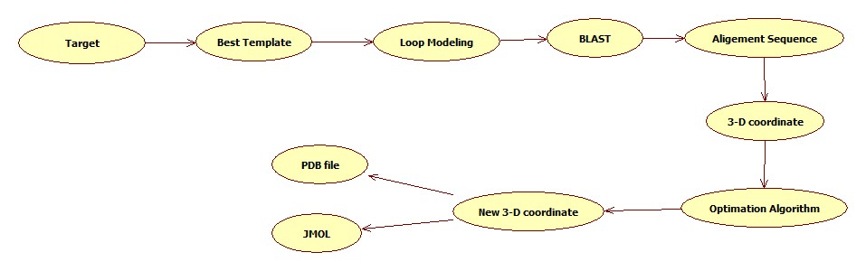
Overview of Pipeline

Slide 5
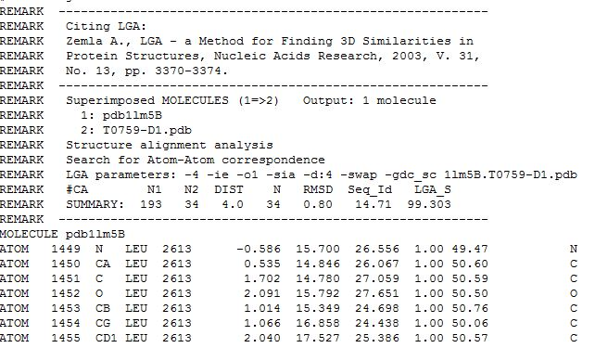
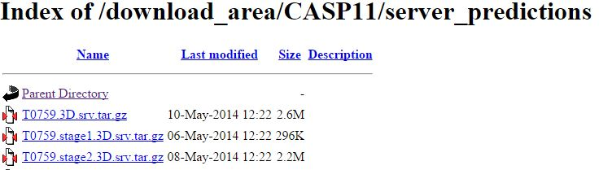
Target & Template
Target: CASP 11
Template:
Best template selected in CASP 11 website
Multiple template (Depend on time)
Example:

Slide 6
Selected Tools
Filling Gaps in Template: Loop Modeling
Input: Start pdbs; Loop file; Fragment files;
Output: ?
Select matched sequence: BLAST
Input: target and template sequence in FASTA
Output: Alignment information
Visualization: JMOL
Input: 3-D coordinate;
Output: Protein Plot

Slide 7
Optimization Model
Ca-Ca distance
Model:
Gradient descent
Conjugate Gradient descent (time?)
Parameter:
Mean: Ca-Ca distance in Template;
Variance: constant / calculated by other protein information

Slide 8
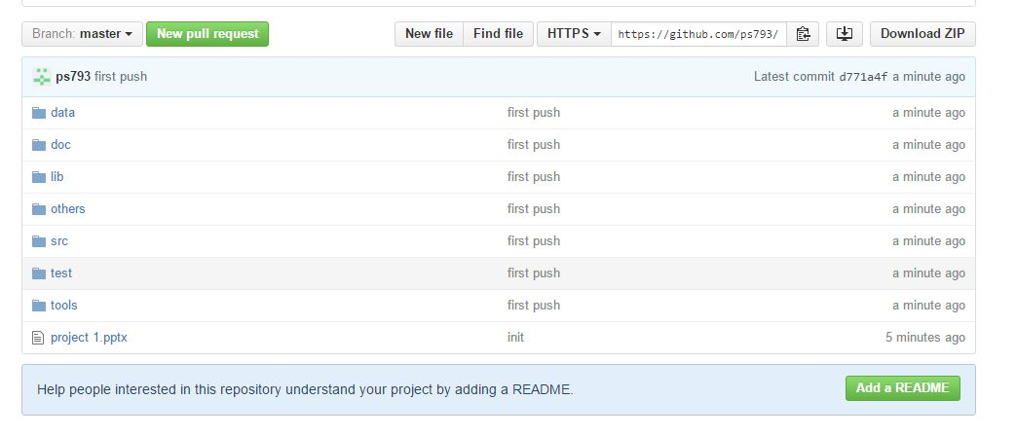
Tools Environment
System: Linux
Language: C/C++
Data sharing:
Github
Dropbox

Slide 9
Task assignment
Xiaohui Yang / Tianbo Wang
Select Target and Generate Template 3-D coordinate
Junlin Wang
BLAST and Loop Modelling
Peng Sun
Optimization Algorithm
Zhaoyu Li
Data visualization

Slide 10
Others
Process track
Each two days have a process track
Timeline
Depends on due day
Result compared
RMSD
TM-score

Slide 11

Thank you !

Slide 12
Any questions ?

